Slide 1
Inventory Management System

Slide 2
Introduction
This project is a full-stack web application developed using React for the frontend and Spring Boot for the backend.
The main objective of the project is to manage customer data efficiently, automate storage of records, provide secure authentication, and integrate cloud-based services such as Google Sheets.
The system also includes an email notification module for low stack of products.

Slide 3
Project Objective
To design and develop a secured and scalable web application.
To implement backend APIs using Spring Boot framework.
To manage data storage using MySQL and JPA.
To provide authentication using Spring Security & JWT.
To include validations, email service, and Google API integration.
To test features using JUnit and ensure reliability.

Slide 4
System Overview
The system is a backend-driven application with REST APIs.
Frontend communicates with backend via HTTP requests.
Backend handles business logic, validations, authentication, and database interactions.
Supports external services like email and Google APIs.
Ensures secure and fast data processing.

Slide 5
System Architecture
Key Layers
Frontend Layer: UI interface (React/Tailwind css).
Backend Layer: Spring Boot controllers, services, repositories.
Security Layer: Spring Security & JWT for authentication.
Database Layer: MySQL with JPA ORM.
Integration Layer: Google Sheets, Google OAuth, Email service.
Testing Layer: JUnit and Spring Boot Test framework.

Slide 6
Technology Stack
Backend Technologies
Spring Boot Web, JPA, Validation
Java 21
MySQL database
Spring Mail Service
JWT for token-based security
Google API Client (Sheets, Drive, OAuth)
Frontend
React / HTML / CSS (if applicable)
Build & Tools
Maven
JUnit
Spring Boot Maven Plugin

Slide 7
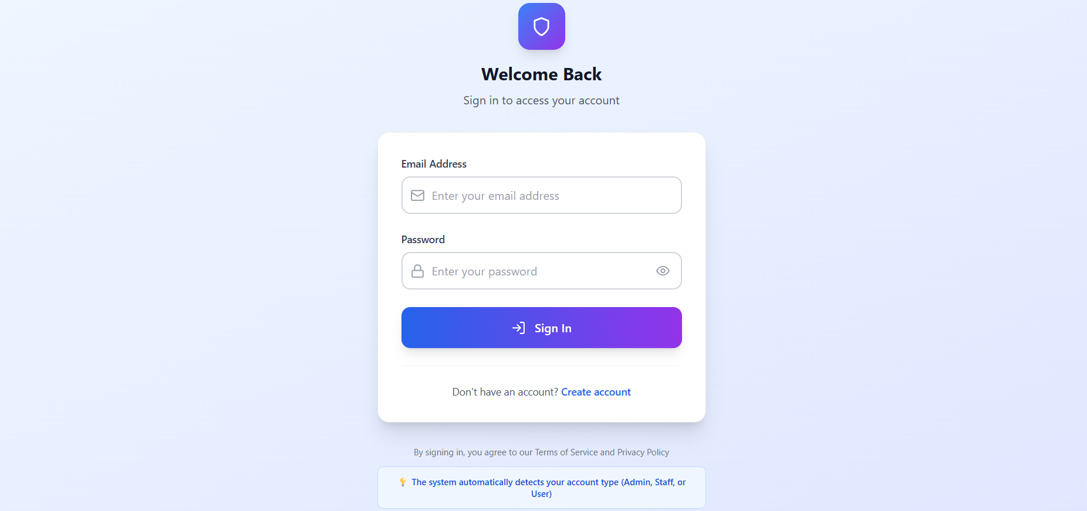
Frontend overview
SIGN IN / LOGIN PAGE

Slide 8
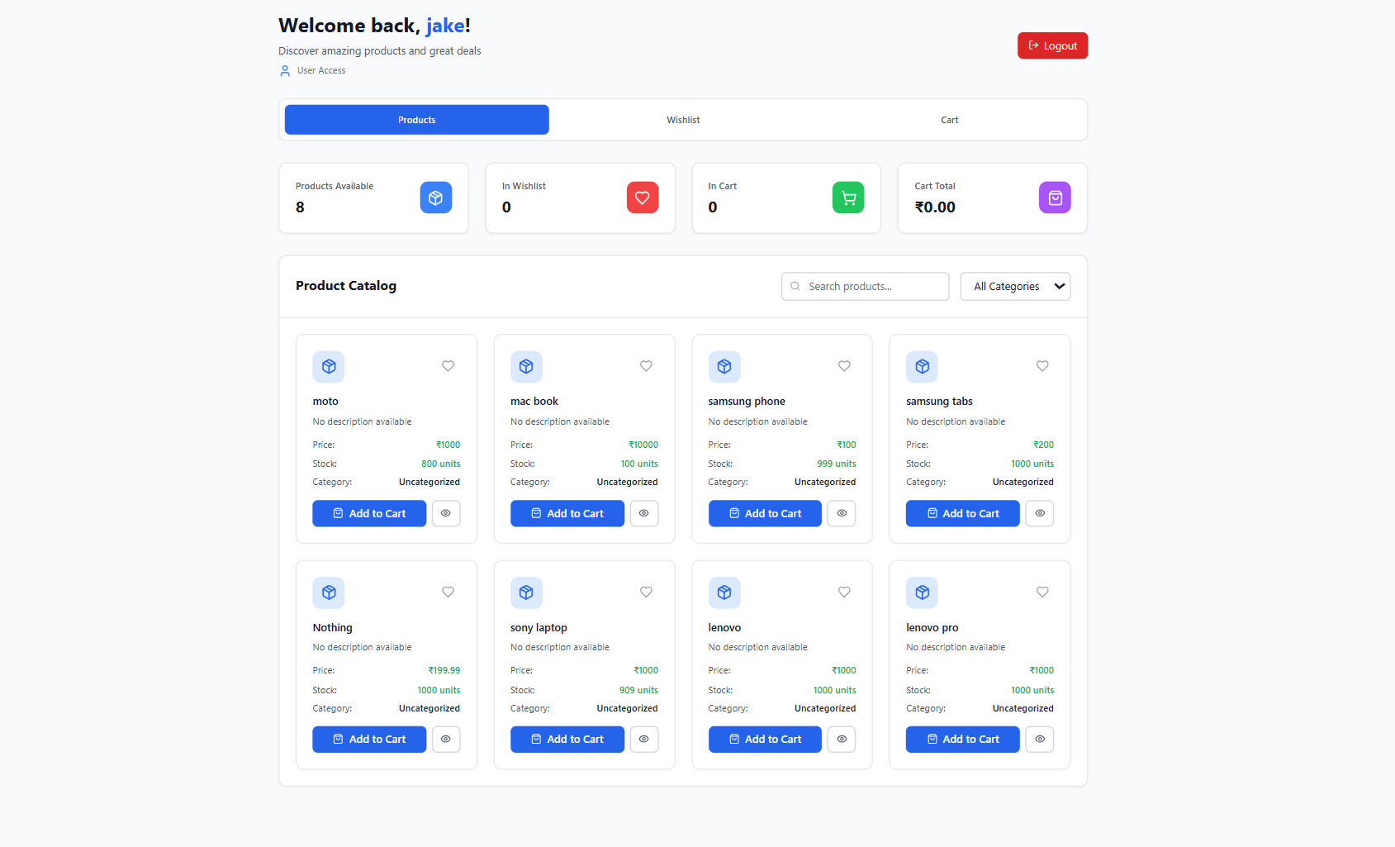
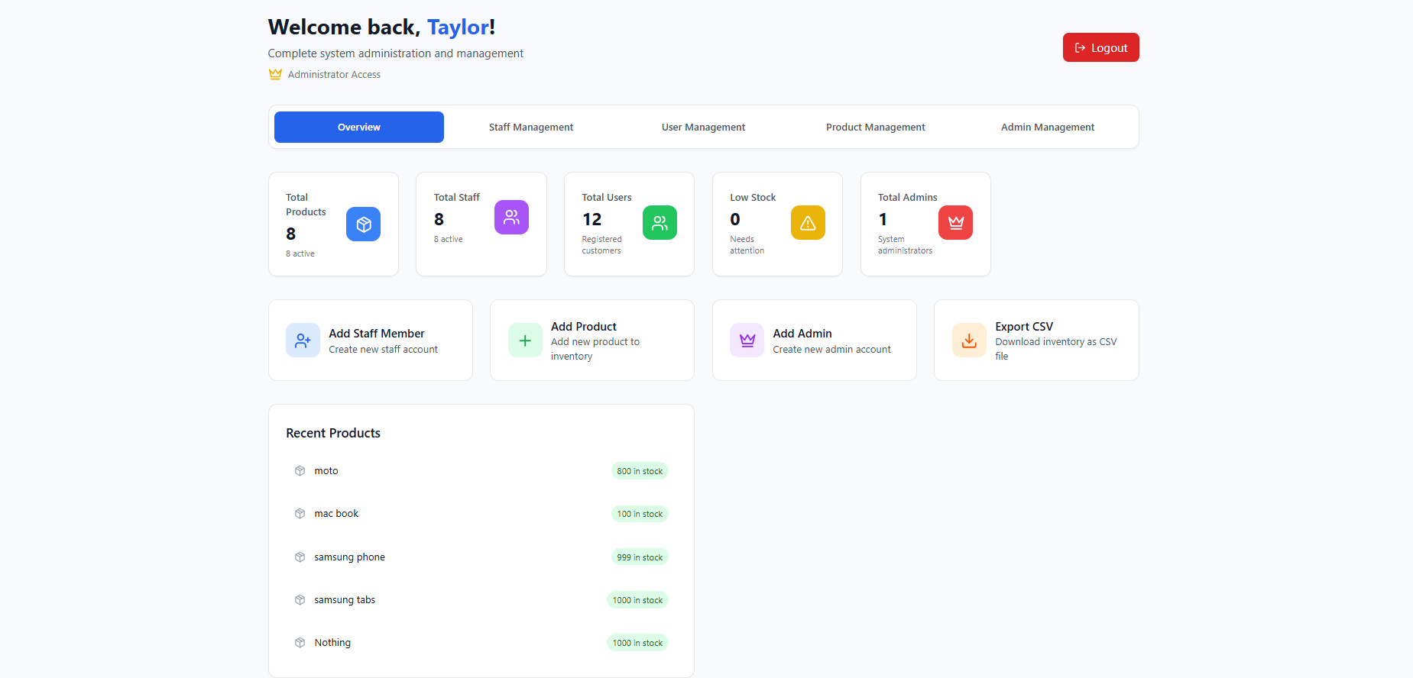
dashboards
Customer dashboard
Admin dashboard

Slide 9
Project Modules
Authentication Module: User login, JWT generation
Validation Module: Input checks using validation annotations.
Email Module: Notifications and OTP-based communication.
Google Sheets & OAuth Module: Data interaction with Google services.
Business Logic Module: Handles all service workflows.
Database Module: Table creation, relationships, CRUD operations.
Exception Handling Module: Global error handling.
Testing Module: JUnit-based tests.

Slide 10
Backend Layer Explanation
Controller Layer
Exposes REST endpoints for client usage.
Handles API requests and responses.
Service Layer
Contains core business logic.
Acts as a bridge between controller and repository.
Repository Layer
Interacts with MySQL database using JPA.
Performs CRUD operations.
Model Layer
Defines entity classes mapped to database tables.

Slide 11
Backend Features
Fully functional REST-based backend.
Handles request validation and error messages.
Service layer ensures proper business flow.
Supports external integrations like Google APIs.
Sends automated emails using mail service.
Implements strong security using JWT and Spring Security.

Slide 12
Database Design
Database Used: MySQL
Features :
Tables created using JPA entity classes.
Relationships implemented (One-to-One, One-to-Many).
Auto schema generation via Hibernate
Ensures structured data storage.
Queries handled automatically through JPA.

Slide 13
Validation Module
Validates incoming user data.
Implements JSR-380 (Bean Validation).
Common validations include:
@NotNull
@Email
@Size
@Pattern
Prevents system errors and improves data quality.
Ensures proper error messages through exception handling.

Slide 14
Email Notification Module
Uses Spring Boot Starter Mail.
Sends emails for:
Low stock of products
Order conformation
Configured with SMTP properties.
Integrated with service layer for automatic sending.

Slide 15
JUnit Testing
Tools Used
JUnit Jupiter (API + Engine)
Spring Boot Test
AssertJ for fluent assertions
Outcome
Ensures system accuracy and reliability.
Tests Performed
Controller Testing
Service Layer Testing
Repository Testing
API Response Testing
Error Handling Testing

Slide 16
Conclusion
A fully functional backend system was successfully built.
Provides secure authentication, validations, and robust processing.
Includes integration with email and Google services.
Ensures quality with JUnit test cases.
Scalable for future improvements.
Easy to integrate with any frontend.

Slide 17
Thank you very much!!

